Slide 1
CHAPTER 3.4:
Expressions & Equations
Algebra concepts

Slide 2
Objectives
Students will write equations that represent written
descriptions of the equation.
Students will solve multistep equations.

Slide 3
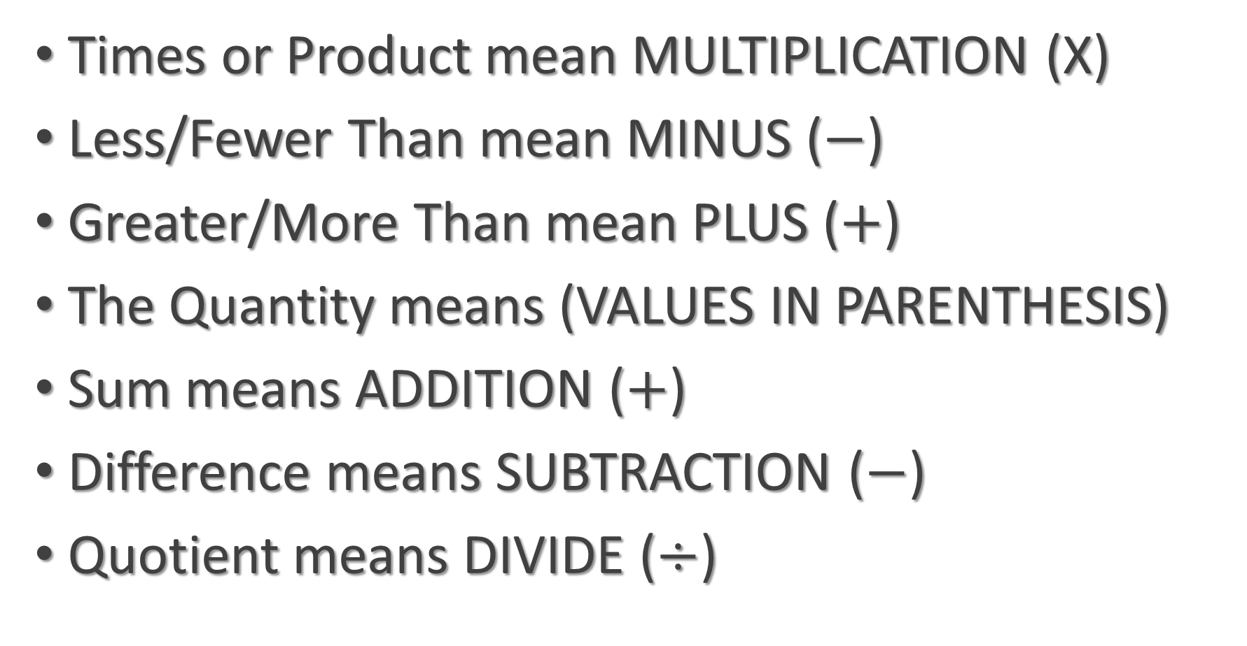
Important Terms
Times or Product mean MULTIPLICATION (X)
Less/Fewer Than mean MINUS ($−$)
Greater/More Than mean PLUS ($+$)
The Quantity means (VALUES IN PARENTHESIS)
Sum means ADDITION ($+$)
Difference means SUBTRACTION ($−$)
Quotient means DIVIDE ($÷$)

Slide 4
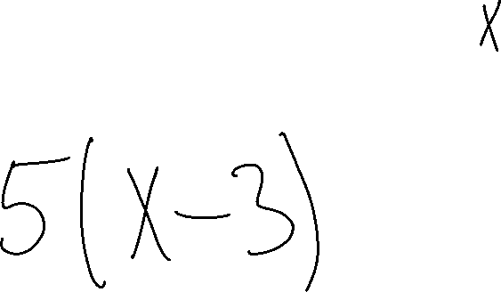
Example 1
5 times the quantity 3 less than a number

Slide 5
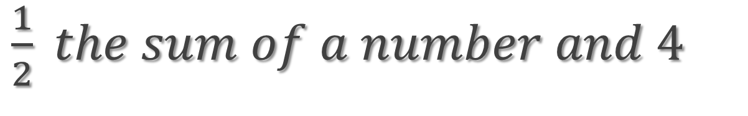
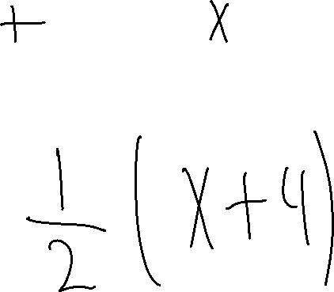
Example 2
$\frac{1}{2} the sum of a number and 4$

Slide 6
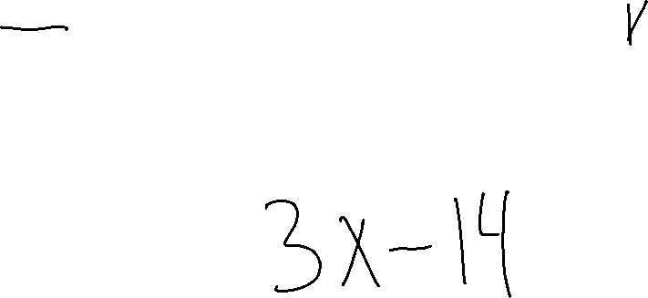
Example 3
14 less than the product of 3 and a number

Slide 7

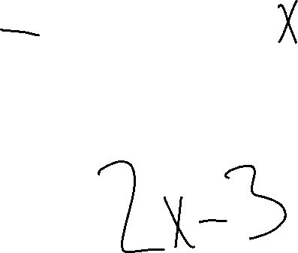
Example 4
$3 less than twice a number$

Slide 8

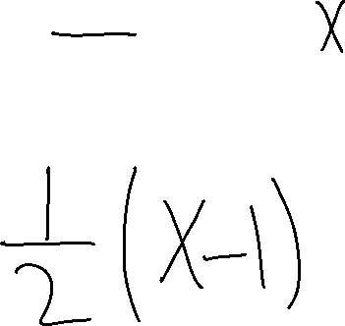
Example 5
$\frac{1}{2} the difference of a number and 1$

Slide 9
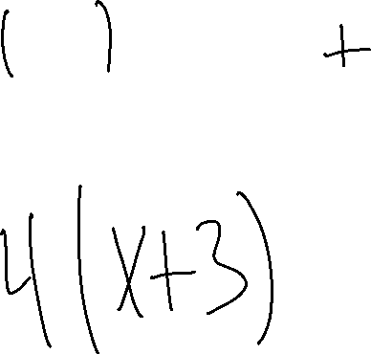
Example 6
4 times the quantity of 3 greater than a number

Slide 10
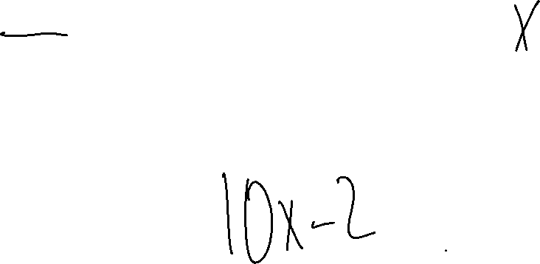
Example 7
2 fewer than the product of 10 and a number

Slide 11
Writing & Solving Equations
Understand
Understand the problem
What am I trying to find
What am I given
Create
Create a plan
What strategies will I use
How to I find the answer
Solve
Find the answer and CHECK!
Does the answer check
Have I stated the answer clearly

Slide 12
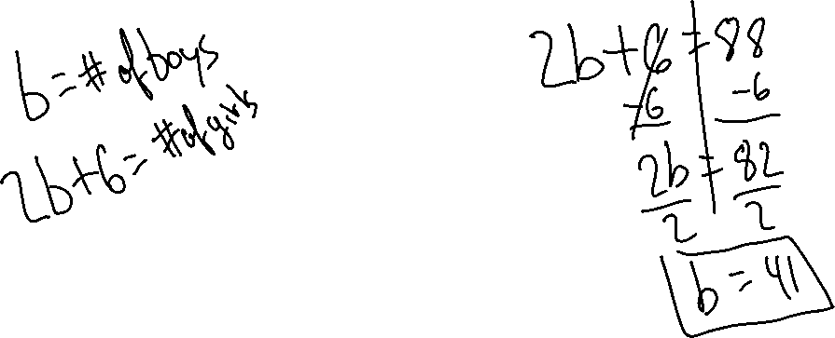
Example 8
The number of girls in the band is 6 more than twice the number of boys. There are 88 girls in the band. How many boys are in the band?

Slide 13
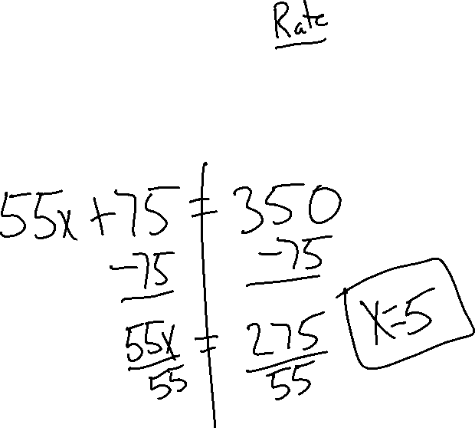
Example 9
Hope has driven 75 miles. She averaged 55 miles per hour. How many more hours must she drive to travel a total of 350 miles?

